Slide 1

GLOBAL GIVING
Hackathon
Joe, Dimitri, Shekhar, Dylan, Phil

Slide 2

What we tried to solve?
HOME
HELP
CHAT 24/7
MAILING
Frequently, your initial font choice is taken out of your awesome hand
Frequently, your initial font choice is taken out of your awesome hand
Frequently, your initial font choice is taken out of your awesome hand
Frequently, your initial font choice is taken out of your awesome hand
Improve accessibility for GG partners so they can post updates on projects to keep their donors engaged.

Slide 3
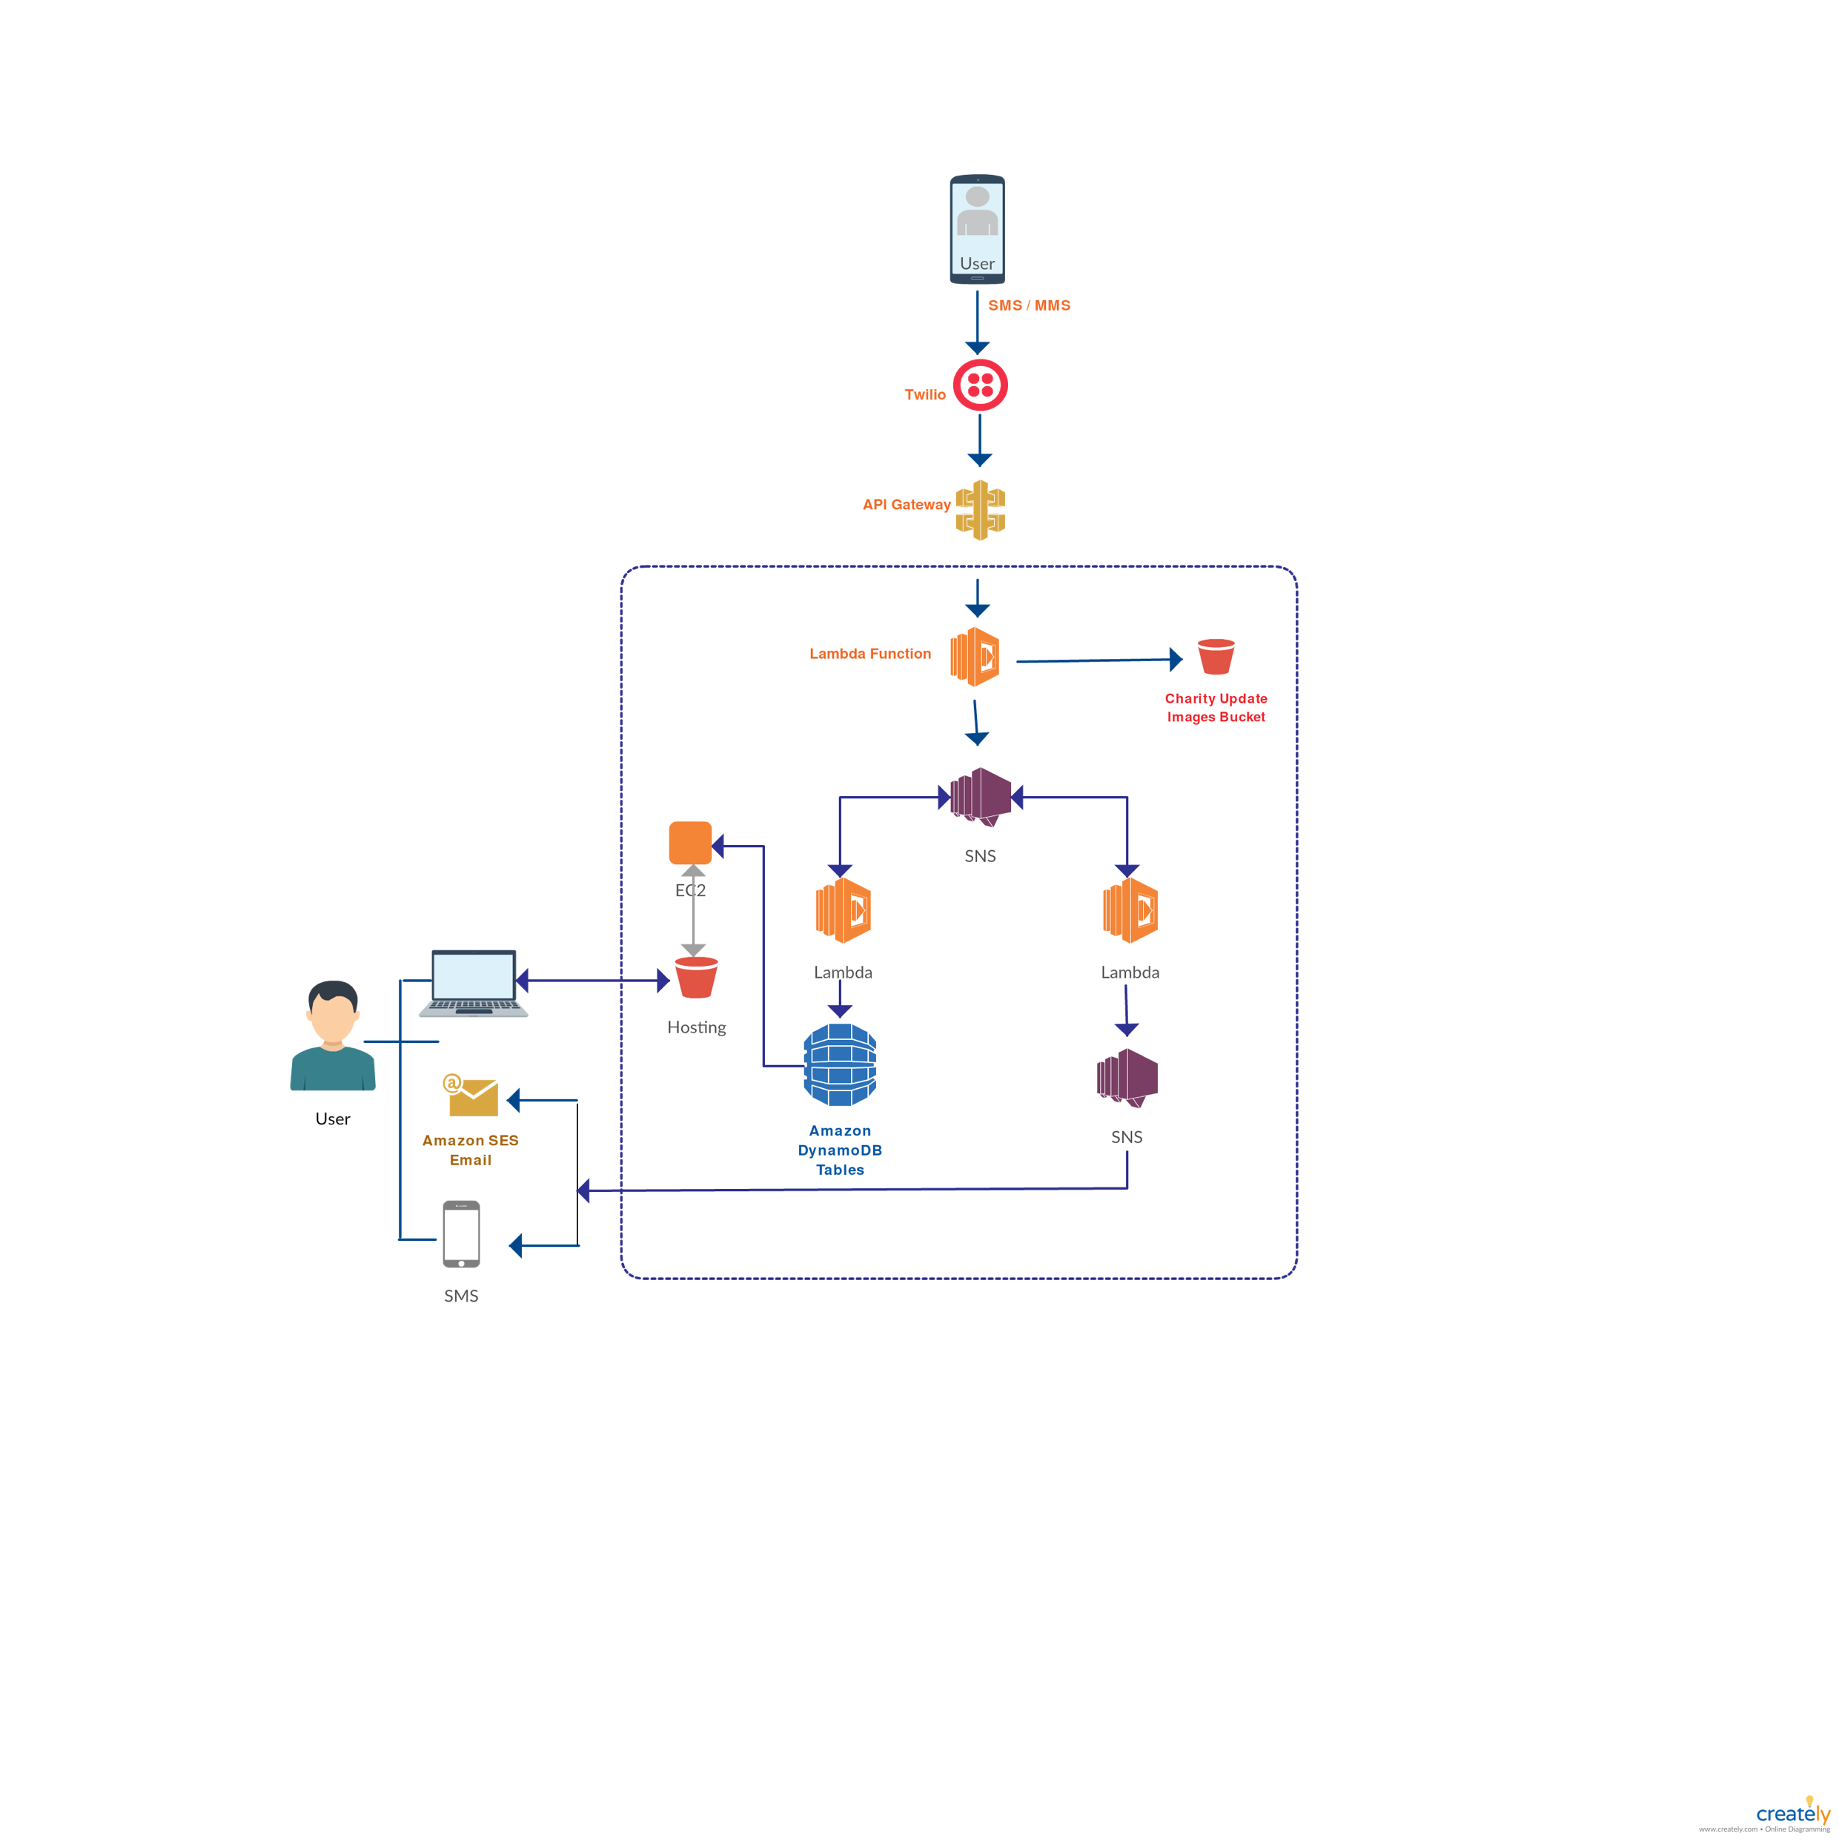
Our
Architecture
Using AWS services to get updates even from areas without any internet connectivity by integrating SMS with AWS cloud architecture.

Slide 4
Features
Real time communication
Best-in-class architecture
Direct integration via GG website
Ability to learn anytime from anywhere in the world with online and offline components
Expertly curated, best-in-class content
on WELL and human health in the
built environment
Streamlined CE reporting experience with automated CE hour reporting to GBCI
Serverless architecture reduces costs
Powered by AWS Cloud Services
Learner-centric platform powered by peer reviews and informed by community perspectives

Slide 5
Future Scope for improvement
Send donor emails via PinPoint
Send donor SMS via SNS
Personalised ‘donor wall’
Rekognition for message validation
Sharing charity updates via social media
Real time ‘likes’ back to the charity

Slide 6

WE’VE LEARNT SO MUCH FROM OUR MISTAKES…
WE’RE THINKING OF MAKING A FEW MORE..
Thank You!

